Slide 1
CIT-422 Computer Graphics and Image Processing Sessional
Pixel adjustment between hardware and software of a digital camera
Rafid al Nahiyan
Id: 1702032
Reg: 7602

Slide 2
Pixel adjustment
Pixel adjustment in a digital camera involves various processes that occur both in hardware and software to capture and process the image data. Let's delve into the pixel adjustment stages between the hardware and software of a digital camera:

Slide 3
Hardware pixel adjustment
a. Image Sensor: The image sensor (CCD or CMOS) is a critical hardware component that captures light and converts it into electrical signals (analog data). The image sensor plays a crucial role in determining pixel properties, such as sensitivity, dynamic range, and noise characteristics. The quality of the image sensor directly impacts the overall image quality.
b. Analog-to-Digital Conversion (ADC): The analog signals generated by the image sensor need to be converted into digital data. The analog-to-digital converter (ADC) quantizes the continuous analog signals into discrete digital values. This process determines the bit depth and dynamic range of the pixel data.

Slide 4
Hardware pixel adjustment (cont…)
c. Sensor Alignment: Some cameras use multiple sensors to capture color information (e.g., RGB). Hardware adjustments ensure proper alignment and synchronization of the sensor data to form a complete image.
d. Optical Components: Lenses, aperture, and filters are essential hardware components that influence the amount of light and the quality of the incoming image. These components impact pixel values by affecting sharpness, distortion, and color accuracy.

Slide 5
software pixel adjustment
a. Demosaicing: In digital cameras that use color filter arrays (CFA) like the Bayer pattern, the raw image data contains only one color component per pixel. Demosaicing is a process in which software algorithms interpolate the missing color information from neighboring pixels to create a full-color image.
b. White Balance: Software algorithms adjust the color temperature of the image to ensure accurate and natural-looking colors. White balance correction compensates for different lighting conditions, such as daylight, tungsten, or fluorescent lighting.

Slide 6
software pixel adjustment(Cont…)
c. Noise Reduction: Image sensor noise, especially in higher ISO settings, can lead to unwanted graininess in images. Noise reduction algorithms are employed to minimize noise while preserving image details.
d. Image Processing: Various image processing techniques, such as sharpening, contrast enhancement, and tone mapping, are applied to improve the overall appearance and visual quality of the image.

Slide 7
software pixel adjustment(Cont…)
e. Compression: After processing the image, some cameras apply lossy compression algorithms (e.g., JPEG) to reduce the file size for storage and transmission purposes. This compression can affect the final image quality, particularly at higher compression ratios.
g. Lens Correction: In software, camera manufacturers may apply lens correction algorithms to correct for lens aberrations, distortion, and vignetting.

Slide 8
Viewing transformation
Construct World-Coordinate Scene Using Modeling –Coordinate Transformations
Convert World-Coordinate to Viewing Coordinates
Map Viewing Coordinates to Normalized Viewing Coordinates using Window-Viewport Specifications
MC
WC
VC
NVC
Map Normalized Viewport to Device-Coordinates
DC

Slide 9
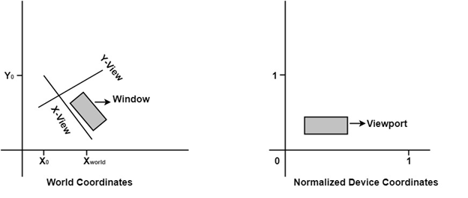
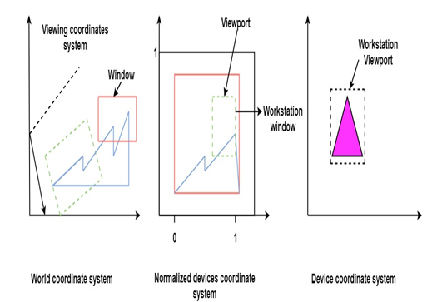
Viewing transformation(cont…)

Slide 10
conclusion
It's important to note that some adjustments, like exposure settings (shutter speed, aperture), ISO sensitivity, and lens quality, mainly occur in hardware. However, many other adjustments, especially those related to color, noise, and image enhancement, are handled through software algorithms in the camera's processing pipeline.
The combination of hardware and software adjustments ensures that the final image produced by a digital camera is of high quality, accurately represents the scene, and meets the user's preferences.

